Slide 1
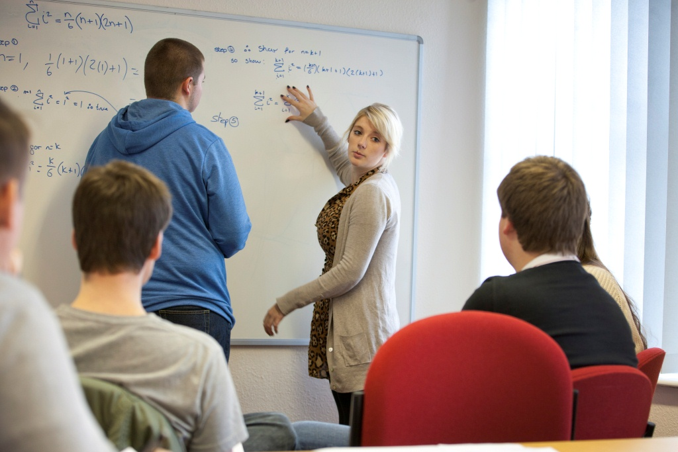
surrounded by greatness
Careers opportunities with a degree in
Mathematics or Data Science
Dr Craig McNeile
craig.mcneile@plymouth.ac.uk
School of Engineering, Computing and Mathematics
Notes:
TEXT SLIDE OPTION 1

Slide 2
surrounded by greatness
Plan:
Different branches of Mathematics.
Overview of Data Science
Overview of the degrees
Careers of some of our students
Notes:
TEXT SLIDE OPTION 1

Slide 3
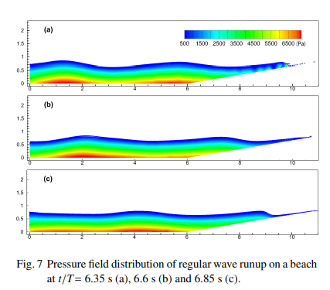
surrounded by greatness
Computer model of waves hitting a beach
Applied Mathematics
Application of Calculus
Fluids
Finance
Engineering
Climate
Notes:
TEXT SLIDE OPTION 1

Slide 4
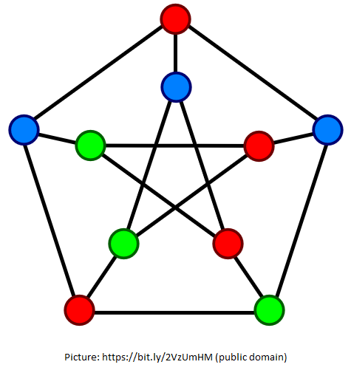
surrounded by greatness
Pure Mathematics
Underlying structures and symmetries.
The study of mathematical concepts independently of any application outside mathematics.
Notes:
TEXT SLIDE OPTION 1

Slide 5
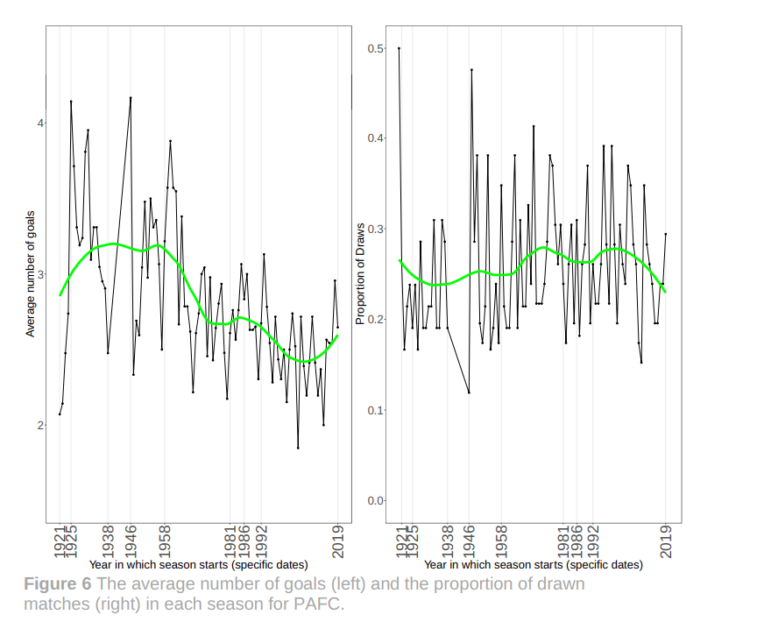
surrounded by greatness
Probability and statistics
Notes:
TEXT SLIDE OPTION 1

Slide 6
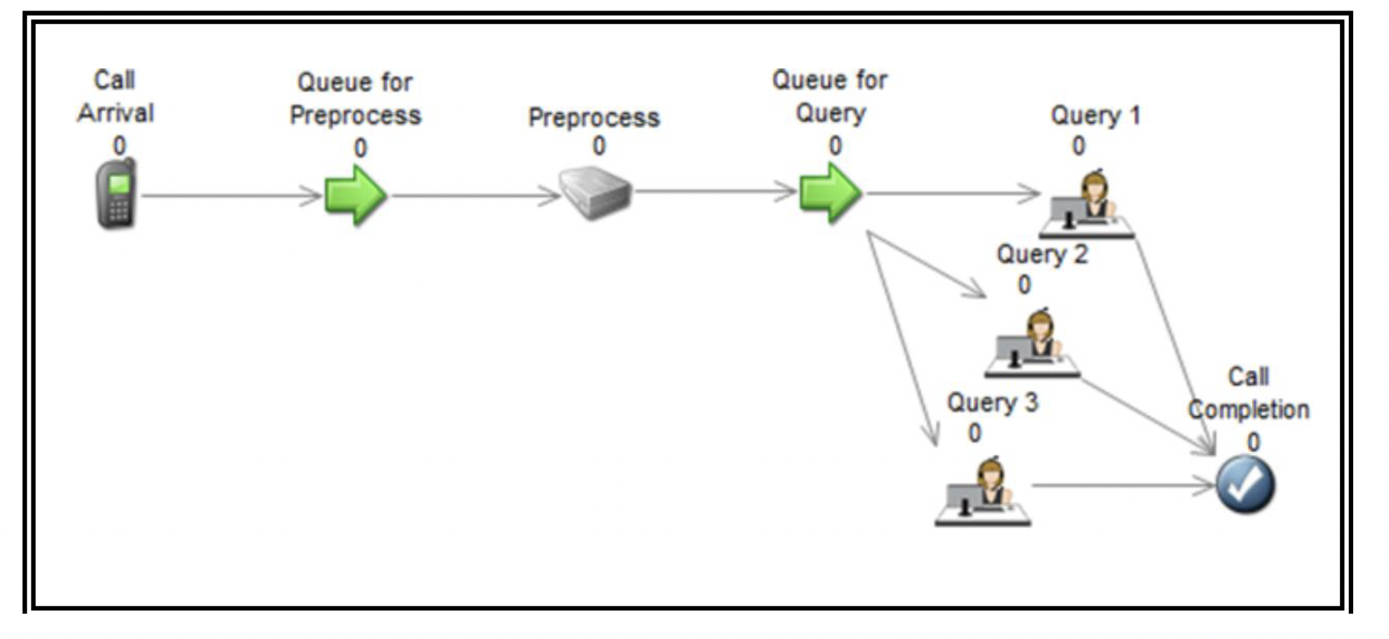
surrounded by greatness
Operational research:
Logistics, planning, simulations,
Optimisation
The mathematics of business.
Notes:
TEXT SLIDE OPTION 1

Slide 7
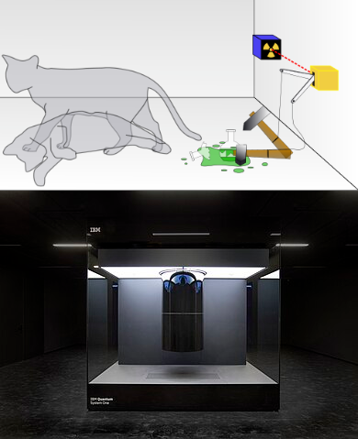
surrounded by greatness
Theoretical physics:
Quantum mechanics
Quantum Computing
Relativity
Notes:
TEXT SLIDE OPTION 1

Slide 8
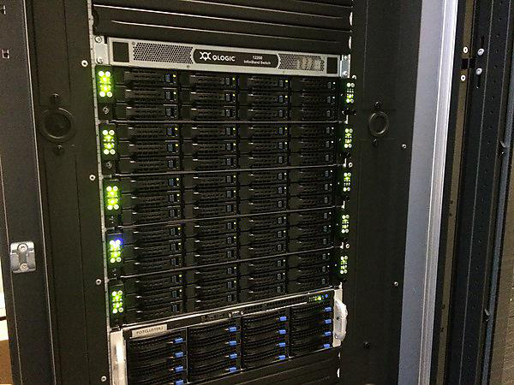
surrounded by greatness
Programming
Computers are required to solve large problems. We teach:
Python
R
Excel
High Performance Computing Cluster
Notes:
TEXT SLIDE OPTION 1

Slide 9
surrounded by greatness
8 sought-after skills employers look for
1. Communication skills
2. Time management skills
3. Problem-solving skills
4. Teamwork skills
5. Digital skills
6. Initiative
7. Project management skills
8. Emotional intelligence
Source Indeed jobs site
Notes:
TEXT SLIDE OPTION 1

Slide 10
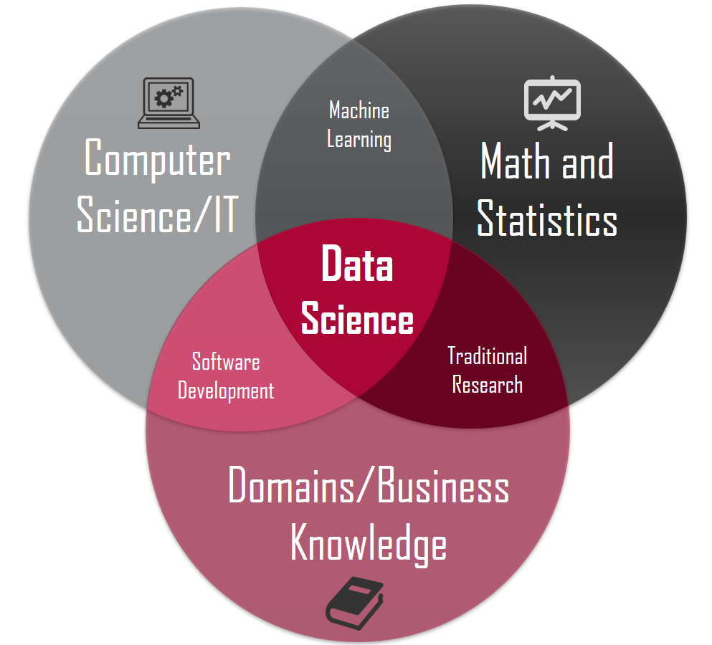
surrounded by greatness
Data Science
Next academic year, 2026/27, there are two new programmes:
▶ BSc (Hons) Data Science
▶ BSc (Hons) Data Science with Artificial Intelligence, with a mixture of modules from Mathematics and Computing.
Notes:
TEXT SLIDE OPTION 1

Slide 11
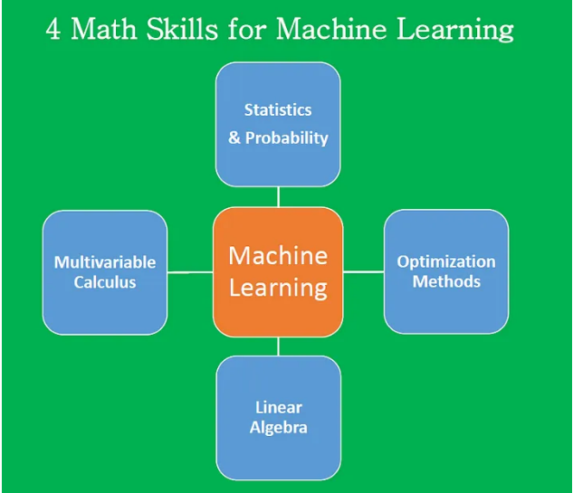
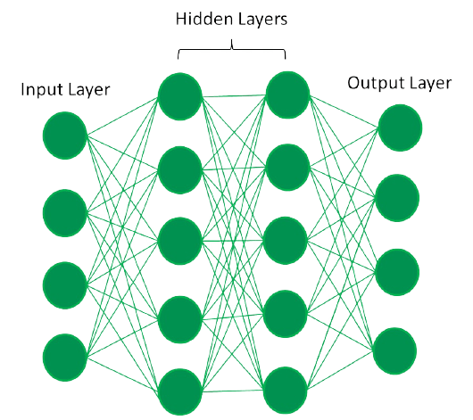
surrounded by greatness
AI and machine learning
One machine learning technique is deep learning, which is based on mathematics
Notes:
TEXT SLIDE OPTION 1

Slide 12
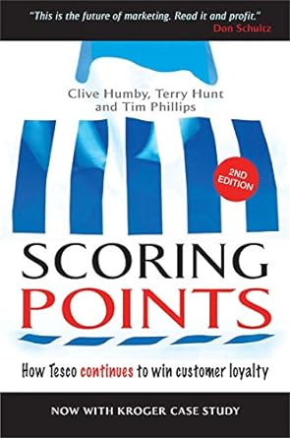
surrounded by greatness
Applications of Data Science
Data Science is used to increase profits of many companies.
Great Ormond Street Hospital for Children
One of the biggest challenges in rare diseases is getting an
accurate diagnosis. Many families go through years of un-
certainty before they find the right answers. By embracing
developments in data science and new technologies, they
hope to reduce the diagnostic odyssey
Notes:
TEXT SLIDE OPTION 1

Slide 13
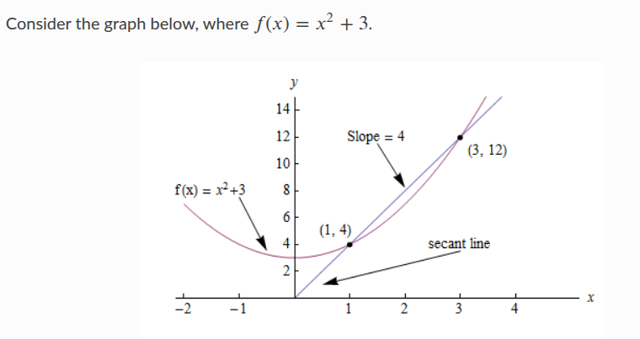
surrounded by greatness
Contents?
▶ First year partly what you expect
(calculus, vectors, matrices).
▶ Much more rigour (proof).
▶ More choice in final year.
▶ Assessment: generally 60-80% exam,
plus coursework (CW). Some CW-only
modules.
Notes:
TEXT SLIDE OPTION 1

Slide 14
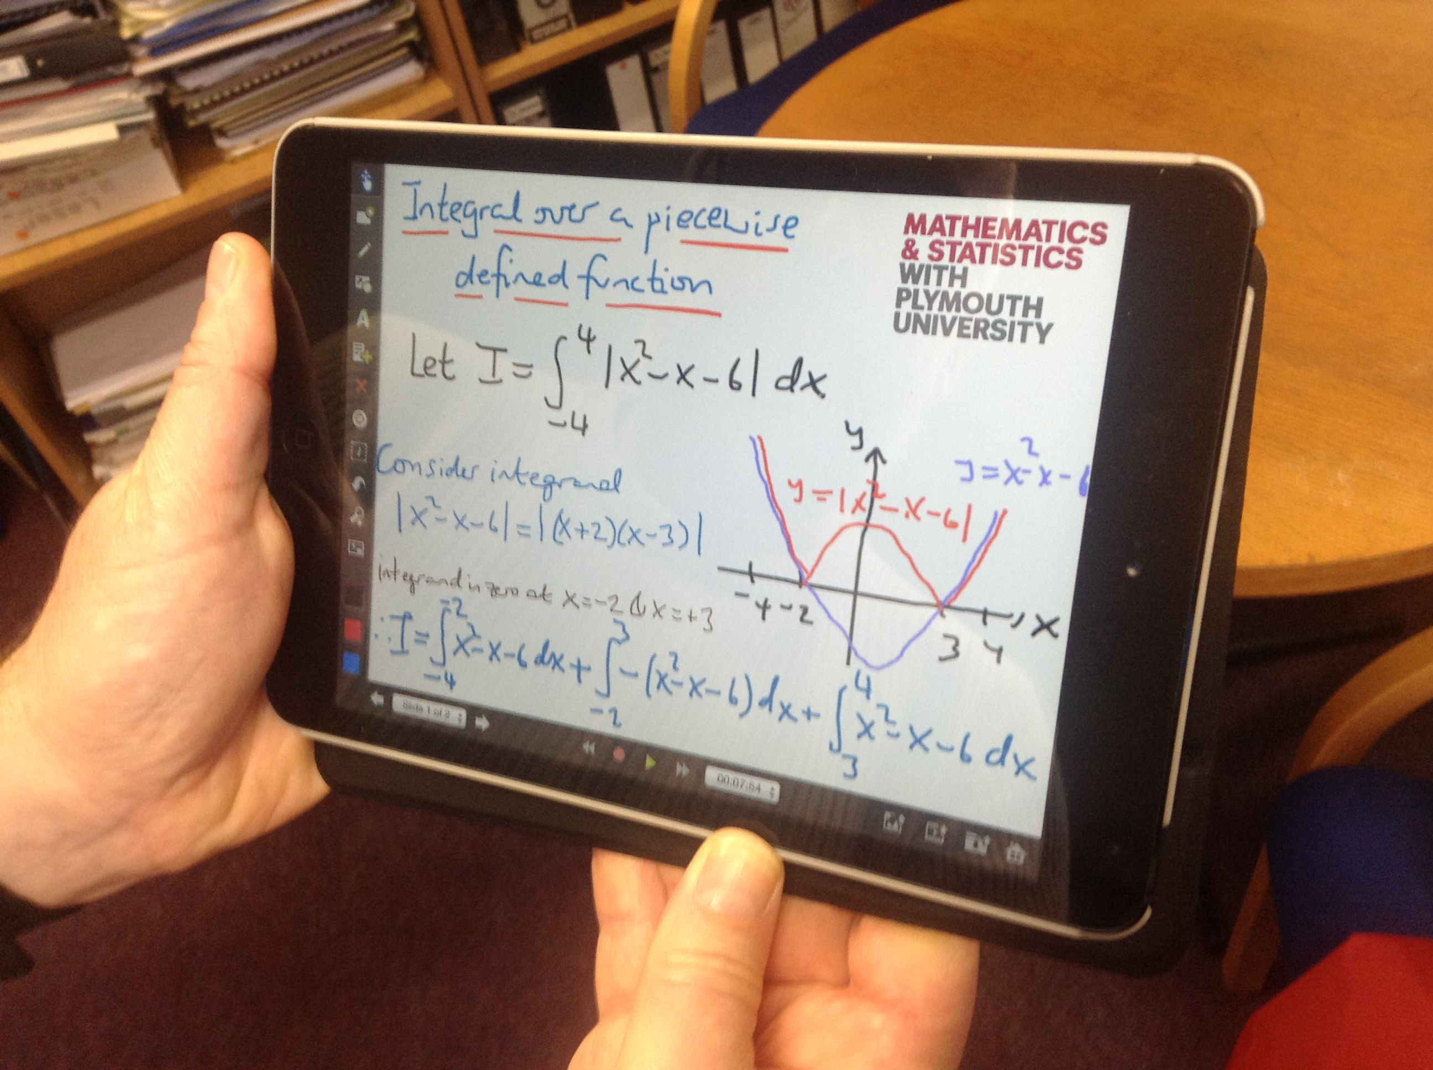
surrounded by greatness
Student Support
▶ Personal tutor system
▶ Drop in centres
▶ Approachable lecturers
▶ Course booklet and recorded lectures
▶ Support classes (tutorials, PALS)
▶ 12 hours of classes (lectures, computer labs etc.) per week.
▶ Employability sessions delivered by professional Careers Advisors
Notes:
TEXT SLIDE OPTION 1

Slide 15
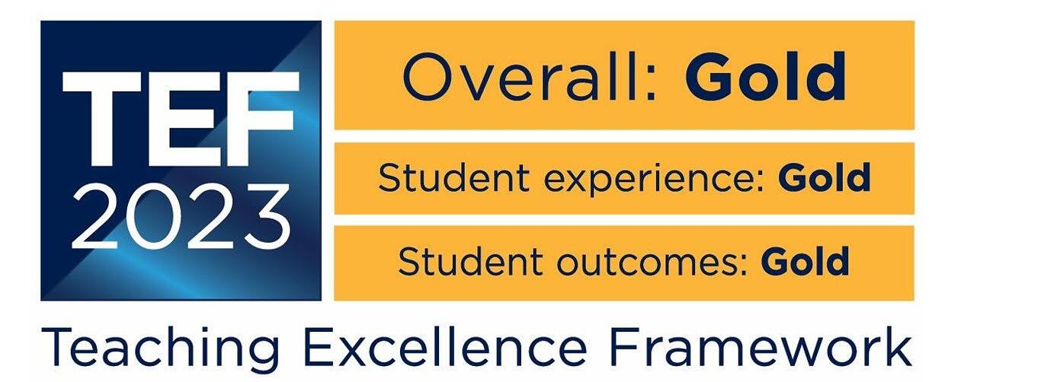
surrounded by greatness
A Track Record of Satisfied Students
Consistent high scores for students’ satisfac-
tion. Guardian Mathematics League Table
▶ 2025: 2nd satisfaction with Mathematics teaching.
▶ 2024: 2nd satisfaction with Mathematics teaching.
▶ 2023: 2nd satisfaction with Mathematics teaching.
87 % of mathematics graduates, from this school,
were working in a graduate jobs after 15 months
(Guardian league table 2025)
Notes:
TEXT SLIDE OPTION 1

Slide 16

surrounded by greatness
Placements and Careers
Year long placements (typically earn £20 k)
Employers include:
▶ Mastercard, ONS, DSTL, Met Office
▶ Glaxo-Smith-Kline, Eli Lilly. . .
▶ Very successful on return
Other placements
▶ Summer placements in industry.
▶ Summer internship scheme for undergraduate research projects
(£2 k). Funded: LMS, Optometry
▶ School placement module
Careers events
▶ Fairs, talks, our own Maths Careers conference.
25 % of employers are using AI to screen jobs applicants
Notes:
TEXT SLIDE OPTION 1

Slide 17
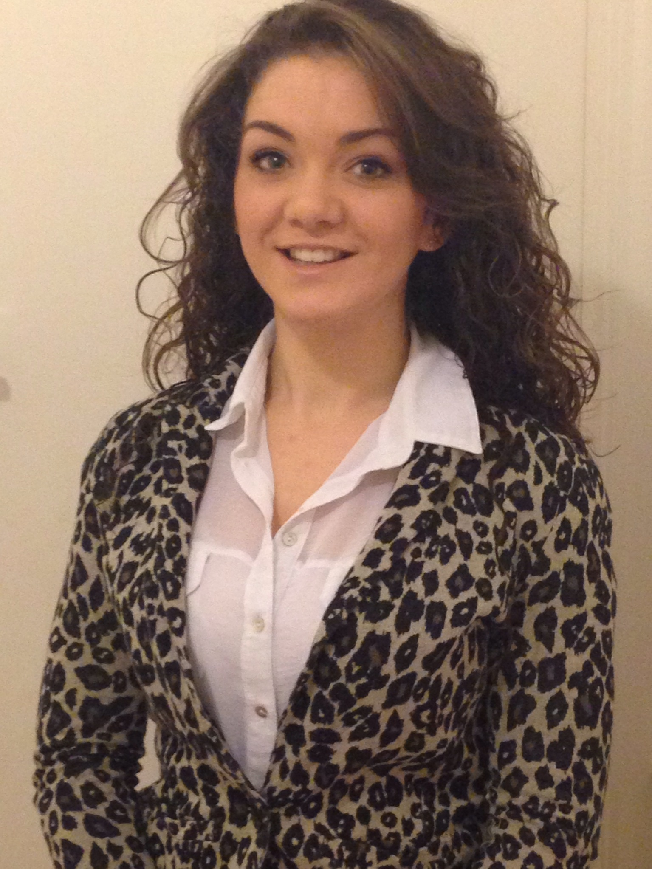
surrounded by greatness
Careers in teaching
Rebecca Dodge: £25k IMA Teaching Scholarship
Notes:
TEXT SLIDE OPTION 4

Slide 18

surrounded by greatness
Careers in Finance
Daniel Palomeque: Senior Actuarial Analyst, Zurich Australia
Notes:
TEXT SLIDE OPTION 4

Slide 19
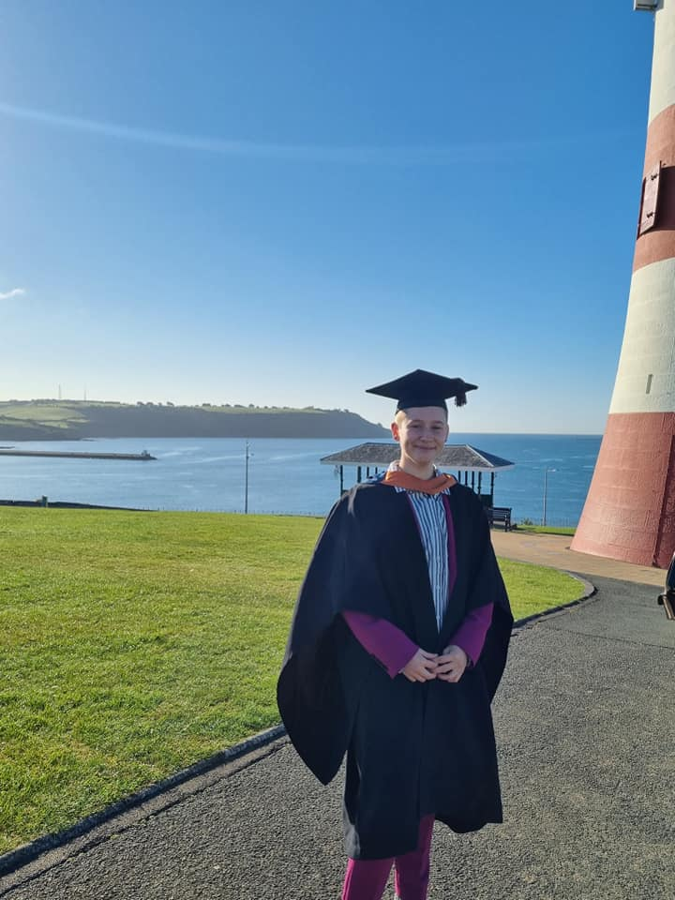
surrounded by greatness
Careers in Medical Statistics
Em Prestige, Doctoral fellow at the London School of Hygiene
Covid lockdowns in the UK: Estimating their effects on transmission.
PRESTIGE, E; Stander, J; Wei, Y; 2022 Significance
Notes:
TEXT SLIDE OPTION 4

Slide 20
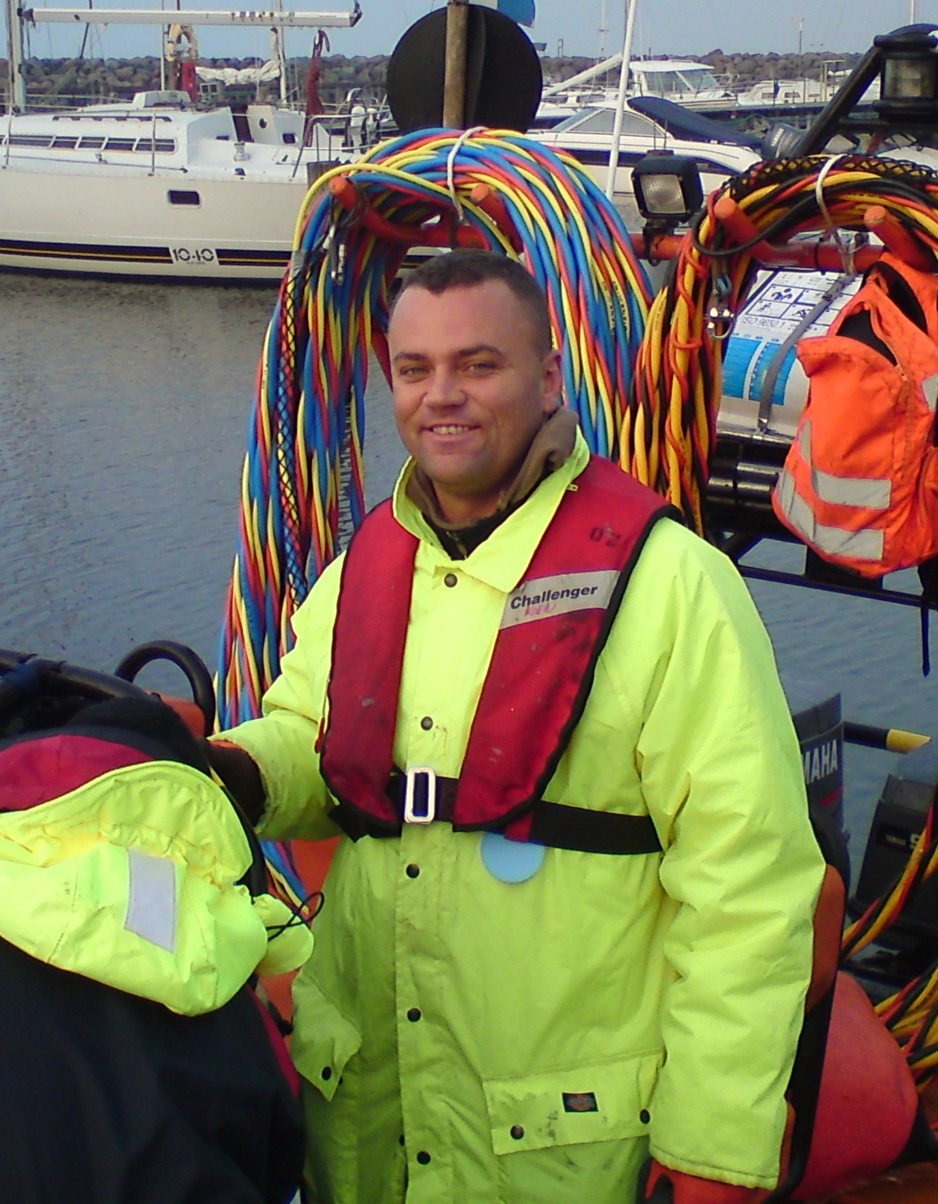
surrounded by greatness
Careers in Computing and Engineering
Tomasz Szyrowski
PhD in Marine Engineering
▶ Mathematical modelling of how to detect undersea cables
▶ Brand new approach (using Monte Carlo techniques)
▶ Scientific Software Developer at the Met Office
▶ Lead Software Engineer at HMRC
▶ Leading a team in IBM to build high performance custom AI applications
Notes:
TEXT SLIDE OPTION 1

Slide 21
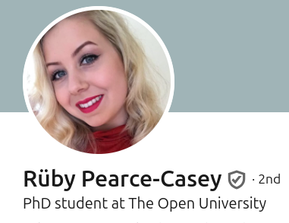

surrounded by greatness
Postgraduate study
A PhD is required to work as a lecturer at a University.
James Mitrussis
MSc student cyber-security at Kings College London Fully funded by a Martingale
Scholarship.
Ruby Pearce-Casey
PhD student at the Open
University. Applying deep learning to images from the James Webb Space
Telescope.
Notes:
TEXT SLIDE OPTION 1

Slide 22
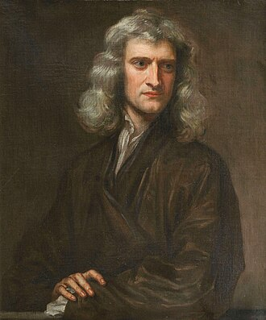
surrounded by greatness
Final year projects
▶ Learning Phases of Matter with Neural Networks.
▶ Algebraic solutions of the hypergeometric equation.
▶ Elliptic Curve Cryptography: A Mathematical Arms Race.
▶ Differential geometry and Einstein’s Field Equations.
▶ Using Machine Learning to Diagnose Pneumonia from Covid-19 in Patients from Chest X-Rays
After inventing calculus, mechanics and gravitation, Sir Isaac
Newton became the warden of the Royal Mint.
Notes:
TEXT SLIDE OPTION 4

Slide 23

surrounded by greatness
Summary
▶ Mathematics degrees keep more career options open
▶ Lots of support during your studies (modern technology)
▶ Students enjoy our degrees (NSS, Guardian)
▶ Data Science and Mathematics lead to well paid and extremely interesting jobs
Notes:
TEXT SLIDE OPTION 1

Slide 24
surrounded by greatness
Notes:
TEXT SLIDE OPTION 1

